Slide 1



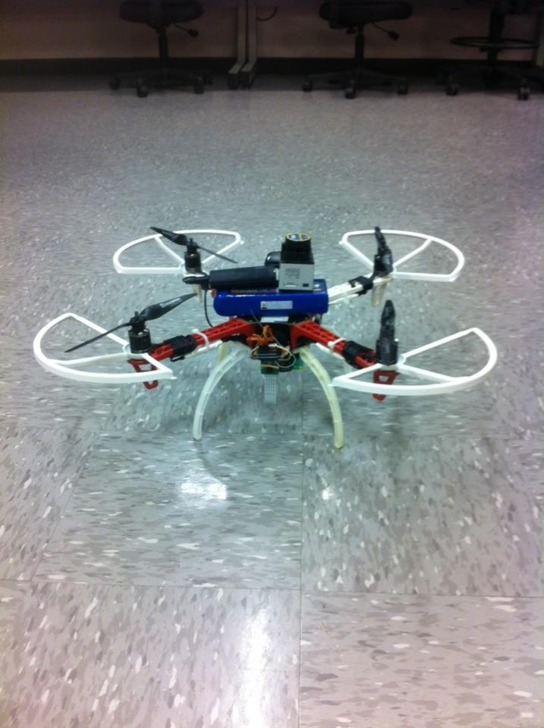
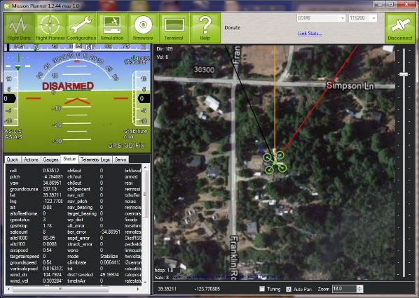
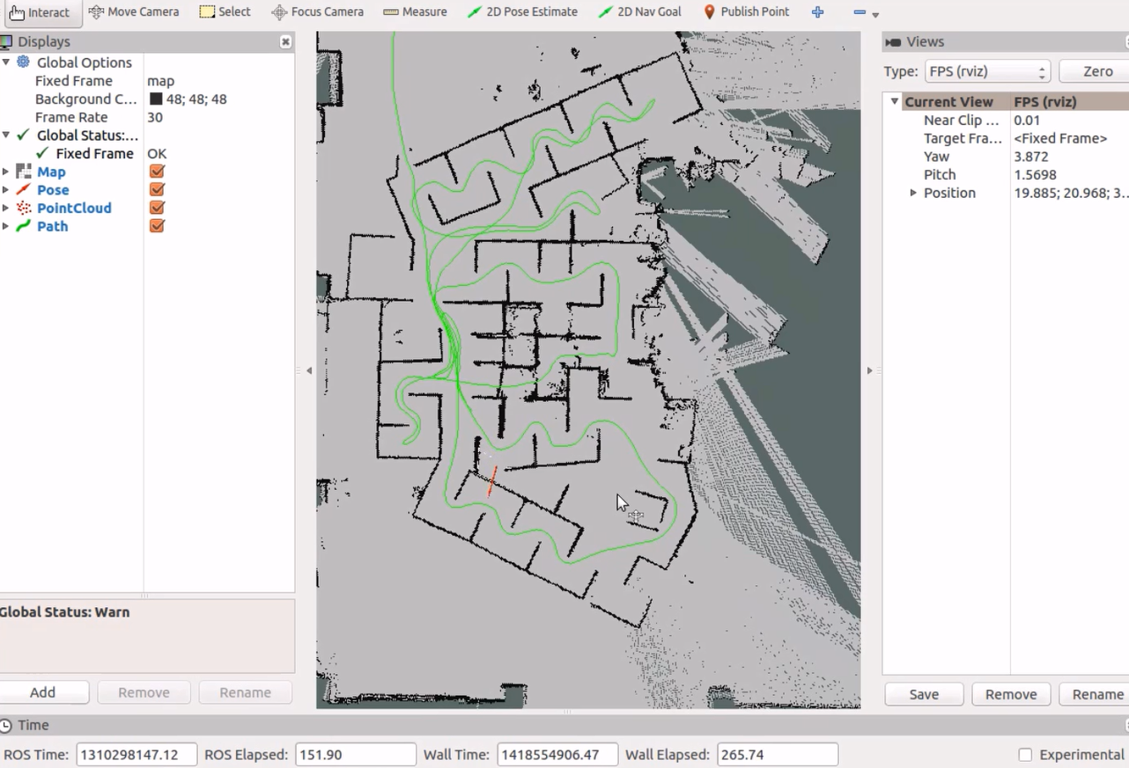
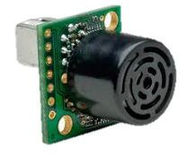
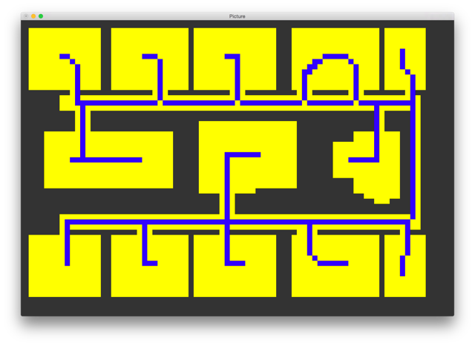
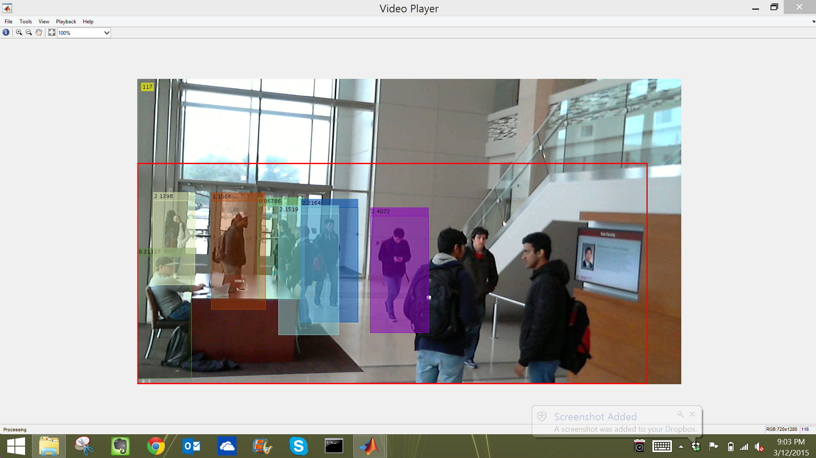
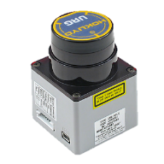
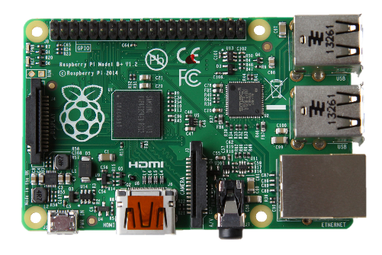
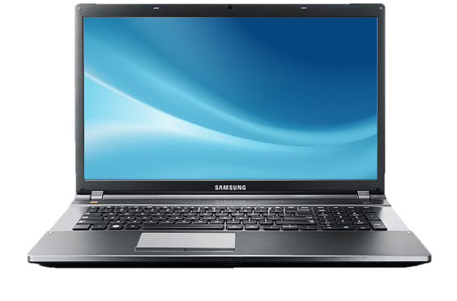

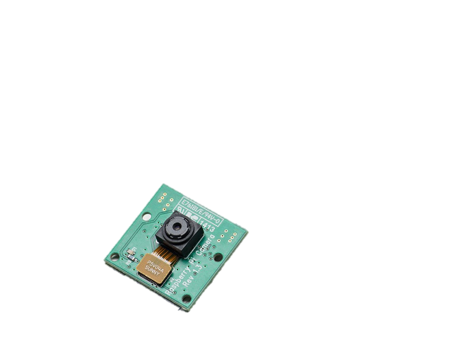
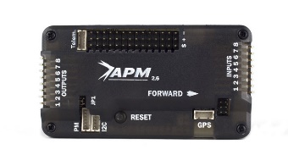
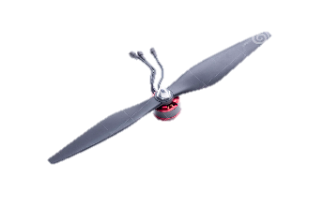
Autonomous UAV
AggiE-Challenge Project - Dr. Bryan Rasmussen - Mechanical Engineering
Michael Kowpak (MEEN), Dayton Savage (MEEN), Bradford Stricklin (MEEN)
Adway Dogra, Allison Badgett, Dennis Moore, Fuhua Song, Jui Yen Chua, Nathan Kocmoud, Spencer Davis
Hardware
Navigation
The UAV is built with a quadcopter design and the APM 2.6 flight controller. The firmware on the quadcopter controls the movement and stabilization of the UAV.
The flight controller uses the Ardu-Copter firmware. Ardu-Copter also allowed the team to easily send data between the APM and the Raspberry Pi. Mission Planner helps stabilize the quadcopter and adjusted the sensitivity of the quadcopter’s controls to accurately fly around a building.
The autonomous requirement for the UAV mandated a mapping system. LIDAR was used in conjunction with telemetry data to generate a 2.5D map.
Using ROS (or Robot Operating System) and Hector SLAM, a mapping system was developed that relies on referential localization. This allows the UAV to keep track of its position despite imprecise accelerometer data.
The time-weighted point cloud is then overlaid on to a 2D grid that determines whether each cell is occupied, open, or unexplored. Using a simple A* algorithm, the UAV travels around the grid to each unexplored cell until a closed environment is completed.
Figure 1. The quadcoptor customized and used for this research project
Figure 2. Home Page of Mission Planner GUI. Mission Planner is used to change parameters on the firmware and provide flight data.
OBJECTIVE
The goal for this project is to design, build and test an unmanned aerial vehicle (UAV) that will navigate a building, count the number of occupants in the building, and be capable of obstacle avoidance. This will all be done autonomously.
The chosen approach for this project is for the UAV to first map the layout of the building by gathering data using on-board sensors. After the map has been acquired, a UAV may use it to implement its occupant search algorithm to effectively count people within a building.
In order to distribute the workload, the objectives were broken down into three sub-teams: Hardware, Navigation and Enumeration.
Acknowledgments
Dr. Bryan Rasmussen, Christopher Bay, Trevor Terrill, the AggiE-Challenge Program, and anyone else who contributed.
References
Dalal, Navneet, and Bill Triggs. "Histograms of Oriented Gradients for Human Detection." 2. ACEMEDIA and PASCA. Web. 10 Oct. 2014.
"Tracking Pedestrians from a Moving Car." MathWorks.com. The MathWorks, Inc., 1 June 2005. Web. 12 Dec. 2014
See backside for references associated with images
Figure 5. Hector SLAM applied to a sequence of data points and associated timestamps. This represents a 2D visualization of mapping data
Enumeration of Occupants
The team’s goal was to count the occupants as efficiently and accurately as possible.
An algorithm called the Zhang-Suen image decomposition algorithm then analyzes this grid of cells and creates a network of paths through all major areas.
The A star path finding algorithm is then used along with ROS to determine a viable path through the map based off of these points.
Integration
2
1
3
7
6
4
5
Figure 6. Diagram of communication between all elements in the system
Figure 3. (Shown on the left) A map generated by the Zhang-Suen algorithm
Figure 4. (Shown on the right) Detected occupants on Texas A&M Campus
The laser range scanner relays data to the Pi
An ultrasonic sensor feeds height data to the Pi
The Pi feeds the data to a base computer which generates a 2.5D map and determines necessary motor commands
The motor commands are fed into a flight controller
Stabilized motor commands are sent to the individual motors
Pi camera sends video stream
Computer tracks individuals on feed and counts people
While the UAV navigates the floor systematically to cover all areas, video is captured and the Raspberry Pi camera sends these video files to the main computer through the Wi-Fi network.
Matlab’s computer vision toolbox contains algorithms that allow detecting and tracking people even while the camera is moving.

